Slide 1
Cash Master Practice
Transition to Total Practice Freedom!
Is your cash flow making or breaking you?
Discover why CMP is the answer!
www.CashMasterPractice.com

Slide 2
Dr. Richard E. Busch III attended Indiana University for undergraduate studies before completing his Doctorate of Chiropractic degree from Parker College of Chiropractic, in Dallas, TX.. Dr. Busch has completed numerous chiropractic technique, pain management, documentation, adjunctive therapy, risk management, nutritional management, personal injury and developed and participated in many health focused television and radio programs for personal education and alternative and conservative healthcare.

Slide 3
CMP Founder, CEO & Lead Instructor is Dr. Richard E. Busch III.
The Busch Chiropractic Center in Fort Wayne, IN. opened in 1996 obtaining its first of eight decompression tables in 1997, operating as a non-participating cash practice from its inception. Dr. Busch developed the spinal decompression protocol as he has successfully treated over 10,000 patients with a variety of conditions. He and his wife Jennifer started Freedom Awaits/Busch All Cash Academy in 2007, consulting and training chiropractors as well as medical doctors from across the country on the implementation of his CMP Protocols for operating cash-based health clinics. You will be learning from the BEST as he is the highest cash grossing sole practitioner chiropractic operation in the nation!
Dr. Busch has been seen on TV

Slide 4
Why a Cash Master Practice?
Doctors have more freedom to treat patients in the manner that is needed to get the best results for the patient, not what an insurance company dictates. There are several benefits to seeing a Master Cash Practice doctor, but one of the most obvious is that if a patient doesn't have health insurance this is the perfect solution for them. Not only are cash case doctors much more affordable than doctors that operate under insurance, but they also offer much better care!
Have a practice that gives you total freedom while reducing operating costs! Cash Master Practices don’t have to wring their hands about reimbursement cuts, or modifiers. There is also don’t need to employ extra staff to handle the administrative work associated with an insurance-based practice.

Slide 5
Why a Cash Master Practice?
Patients get the best results. Because they have a tangible
investment in their own care, and the doctor’s treatment is not
dictated by an insurance company. There are no obstacles to
achieve the best outcome.
Cash-based practice bring transparency to healthcare.
Patients know exactly how much they are going to be charged and don't have to worry about being surprised by a bill or collection letter later.
Doctors want to spend more time with their patients. When doctors don't have to spend hours creating records for insurance companies, they get that time back to really focus on the patient!

Slide 6
Why a Cash Master Practice?
Another benefit to Master Cash Practice doctors, for both the patient and the doctor, is that you generally get more time. That’s big reason so many doctors have moved to a cash case model; they want to spend more time with their patients to get better outcomes. When doctors don’t have to spend hours creating records for insurance companies, they get that time back to really focus on the patient. Cash Master Practice doctors are an excellent way for people to get quality care whenever they need it at an affordable price!
When you are a Cash Master Practice, you become your own boss. You no longer must appease administrators nor pay their lofty salaries in this model. Additionally, you get to be as creative or uncreative as you want to be.

Slide 7
What patients are best?
A cash case based spinal decompression or neuropathy practice must focus on treatment of the right patients. CMP has broken patients into a few distinctions and have found the best for treatment to be the “chronic patients” to be the most successful. These patients will be in someone’s office for treatment, provide the proper treatment, they will respond well to the care. Another classification of patients is the “semi-chronic”. They are a little more difficult to deal with but if handled properly they are great patients as well. Providing successful treatment alternative for patients that have been told surgery, injections, medications and physical therapy are their only treatment options provides the best opportunity for building a strong reputation. CMP will teach you to spot both classifications and give you the tools to not only get the patient to pay for and start care but get the best results at the same time for the health needs of the patient!

Slide 8
What patients are best?
Can your local market support this type of practice? Any community can support this type of practice. Patients that are motivated to get well are willing to pay for the care that they receive providing they feel they will it is worth while and will respond to the care! Since the advent of the Affordable Care Act almost everyone has a high deductible insurance. Most everyone now have HSA’s which gives them the freedom to spend their money where they want. This is the perfect market for a Master Cash Practice.
MCP offers non-recourse financing for patients that can’t afford to write a check!

Slide 9
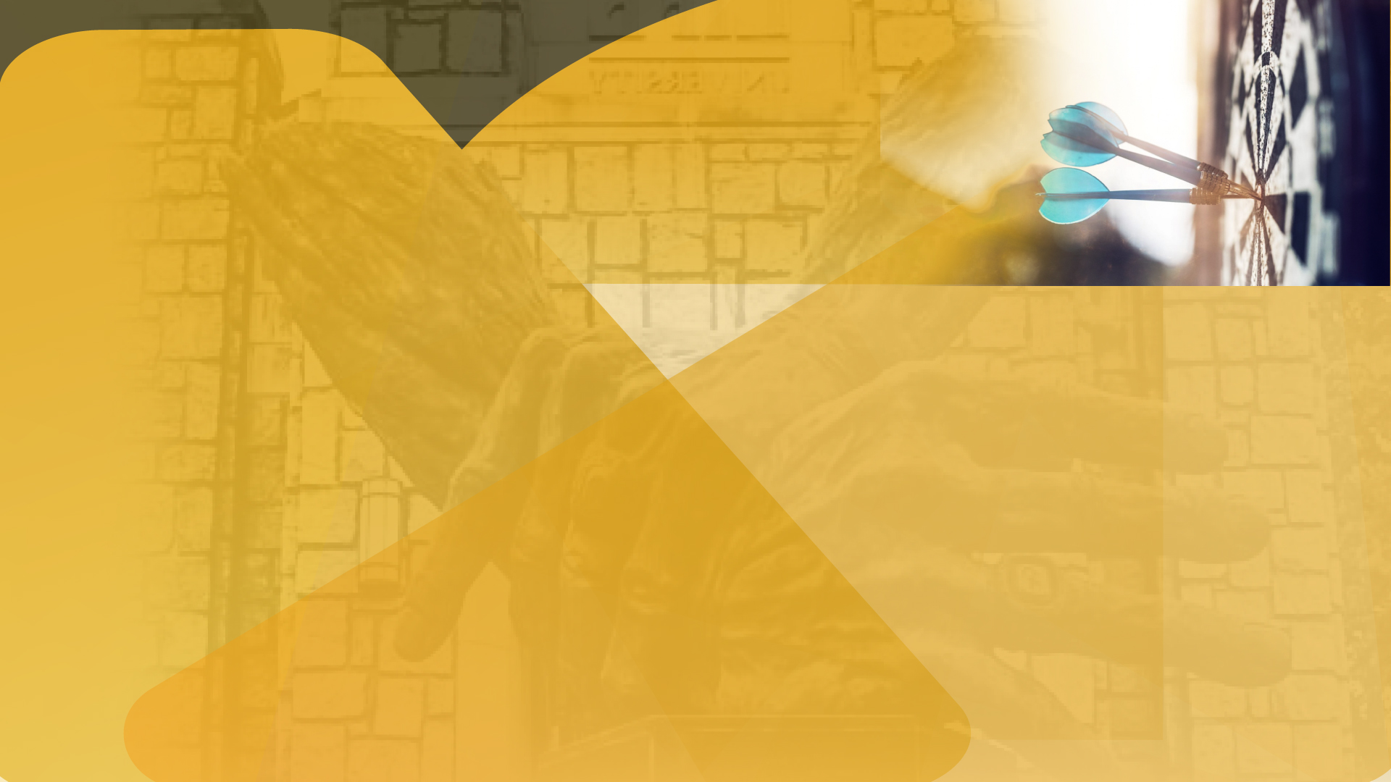
Focused Marketing is a MUST!
Your message is key! Must be focused and distinct in its delivery. Don’t give anything away for free or discounted. Free offers devalue your services and reputation. CMP course graduates receive a marketing package with all marketing details & services Busch Chiropractic uses for print, broadcast radio and television & internet marketing groups too.
You will also receive the formula to know your metrics, to see what your marketing dollars are resulting in cost to acquire a patient. Busch Chiropractic clinic generates 7 figures a year due to protocols of the CMP polices, plans & procedures. Have a plan & stay consistent!

Slide 10
Handle patients correctly!
The new patient phone call, consultation, initial exam and report of findings must be handled in an exact manner to ensure the patients accept care and receives the best possible results. Patients must be “disarmed” throughout the process, the Scripting is vital! Do the same thing every time and you will get the same results. CMP provides you the doctor and your staff with all scripting in each phase of the process! Poor control will get a poor result. Nothing can be skipped or brushed aside as not essential in the procedures. CMP takes away all the guessing and speculating, it is a tried-and-true process that the results are evident for hundreds of graduates of the course over the last 15 years.

Slide 11
Handle patients correctly!
When a patient decides to accept care, it is because they have made an educated decision. They are paying for the doctor’s time, knowledge and expertise. The doctor is always in charge and patients do not dictate treatment in any way. Your staff is an intricate part and must know their role in the process. Answers and treatments must be consistent between staff members. Consistency is very important; everyone must speak the same language for understanding to take place within the patient! CMP provides every detail needed to accomplish these policies & procedures.

Slide 12
Patient Treatment
Staff must know when to get the doctor involved. Proper note taking is essential. Doctor must always know how patients are progressing with the treatments. Positive reinforcement is very important. Above all else, being a doctor means being available to the patient. The doctor-patient relationship only flourishes when the patient knows that the doctor has time, not only to spend with them in an appointment, but in availability to discuss issues that arise as well.
CMP’s view, the problem boils down to the insurance model: There are too many demands on the physician (charting, billing, insurance pre-authorizations, etc.) to give the patient adequate time. Chiropractic is time-consuming (for both patients and doctor). With that said, CMP practices produce excellent outcomes—all the time and energy spent with patients is worth it!

Slide 13
Long Term Care
Give more care than what was paid for! A maintenance, or continuing care must be offered to patients to help maintain the results achieved with treatment. Patient should be prepared by doctor for this prior to having it presented. This must be done at the appropriate time – not too soon, or too late. When Busch Chiropractic has surveyed their patients about the cash-based model, the patients agree: “It’s a lot more practical, a lot less expensive, and what’s important to me is getting better and staying well!” Busch Chiropractic retains 75%+ of there patients for 5 plus years.

Slide 14
What a Cash Master Practice can achieve
A Practice may expect to collect $10,000 to $50,000 or more monthly when implementing the program as instructed. Average start rate can be 75% or better for prepayment plans when the CMP protocols are followed. Average case fee collection per patient may be $3K to $5K. There will be exceptions to this & can be modified depending on services offered. The fee must be based on what is needed and necessary and what is appropriate for the patient. We discuss fees in-depth in the CMP workbooks and videos and will make sure the doctor and staff have an understanding in how fees are developed throughout the weekly video conferences.

Slide 15
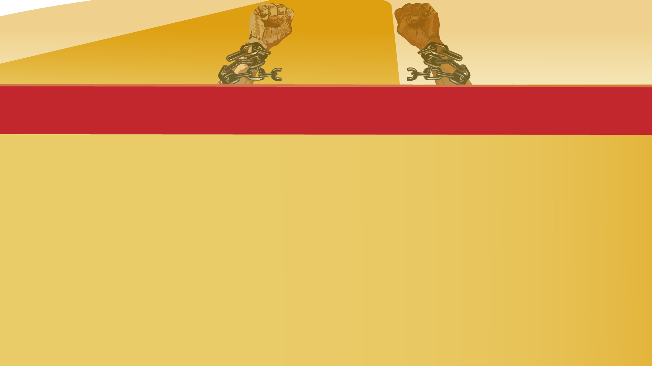
Why do the online Cash Master Practice curriculum?
Studying online gives you more flexibility. You can work and fit your work schedule (and your hobbies) around your coursework more easily. By studying online, you choose your own learning environment that works best for your needs: your bedroom, your study, the café, or your local gym, listening to your instructor’s lectures as you run on the treadmill. Isn’t that awesome?
Doing the CMP online course also means that you don’t have to commute to the Fort Wayne, IN. clinic for 2.5 days at a cost of $25,000.00. Compared to $4,897.00 for a 1-year subscription plus $97.00 a month after month 2 or $970.00 for the year for the weekly video coaching and Q & A with Dr. Busch and the other instructors Jennifer and Rachel. The weekly meetings will assist you in staying motivated! The weekly video conferences will also help you network with your peers for the doctor and their staff!

Slide 16
What can you expect as Cash Master Practice client doctor?
Upon completion of the course which entails 20 plus hours of video showing step by step processes with a patient for both DC and their staff, along with transcripts of all procedure video’s. Weekly video conferences for both doctor & staff with Dr. Busch and his instructors. 6 complete workbooks for both the doctor and staff that include all forms, policies, procedures and plans. Go to this video testimonial by Dr. Kehrig, hear for yourself what you can expect. https://www.youtube.com/watch?v=bLx7UFPDB9M
Graduates of CMP will be introduced to a financing company for your patients that need financed. You will have access to all marketing companies Busch Chiropractic uses, as they see on average 100 plus patients a day. You will have access to all medical devices, equipment manufacturers & supplement companies used by Dr. Busch. You will have a complete A to Z operational protocol system to operate a thriving Cash Master Practice.
CMP limits enrollment nationally and locally to not oversaturate the market. Don’t let this knowledge pass you by, for your future,
you deserve the FREEDOM TO THRIVE! www.CashMasterPractice.com

